Slide 1
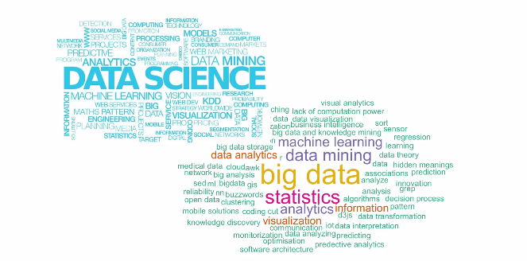
Data Science – Day 1

Slide 2
Building Footprints demo

Slide 3
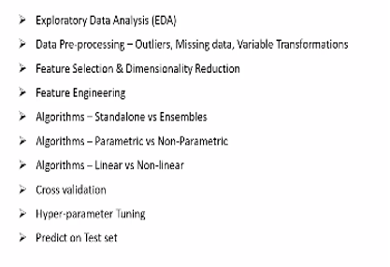
Team details Overall coverage
Github info: https://github.com/ammumadhu/PPSDS

Slide 4

What is Data Science anyway ?

Slide 5
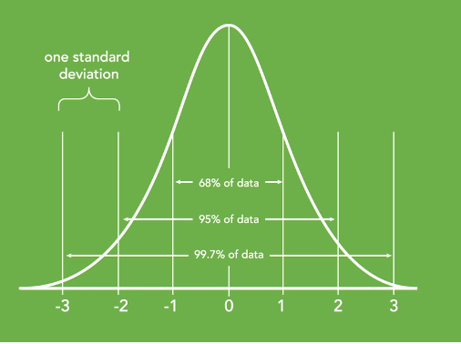
2,4,6,8,9,10,?
A,C,E,G,?
2,4,6,8,9,10,15,18,21,28, ?
A,B,E,W,T,Y,Q,W,S,A,Q,R,,..?
Business triggers the analysis of data through mathematical parlance supported by technology

Slide 6
Data
Decision Making
Event 1 : Technological developments – Plethora of data
Quantitative analysis
Event 2 : Advances in enormous computing power & faster algorithms Data Visualization
Event 3 : Large data storage capability , Cloud computing , Parallel computing

Slide 7
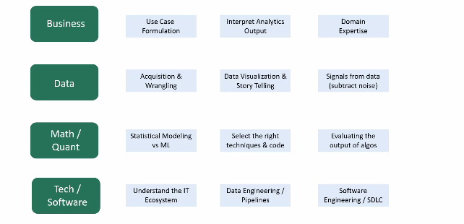

Slide 8
Variants of data science
Statistics
Data Science
Machine Learning
Deep learning
Artificial Intelligence
Business Analytics

Slide 9
What should be there in my arsenal to effectively practice Data science

Slide 10
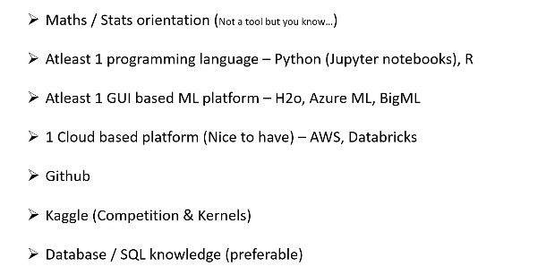

Slide 11
References :
Linear algebra Done right
Our 11th & 12th standard Mathematical books
ESL by Trevor Hastie
Datasciencecentral.com , r-bloggers , AnalyticsVidhya , dataelixir

Slide 12
Data Science Taxonomy ?

Slide 13
Data Science
Supervised
Parametric
Non Parametric
Unsupervised
Clustering
Reinforcement
f(x)
KNN

Slide 14
Data Science Workflow ?

Slide 15
Take a first look into the data ; Determine obvious issues and relevant data points
List of data points and issues to fix
Make the data usable
Preliminary Report
Load the data into an adequate tool / framework
EDA
Data Visualization and Story Telling
Select the features
Train the model
Evaluate the model
Performance Measurement & optimization

Slide 16
Practical uses of Data science

Slide 17
http://www.denseinl2.com/webcnn/digitdemo.html

Slide 18
R

Slide 19
Appendix

Slide 20
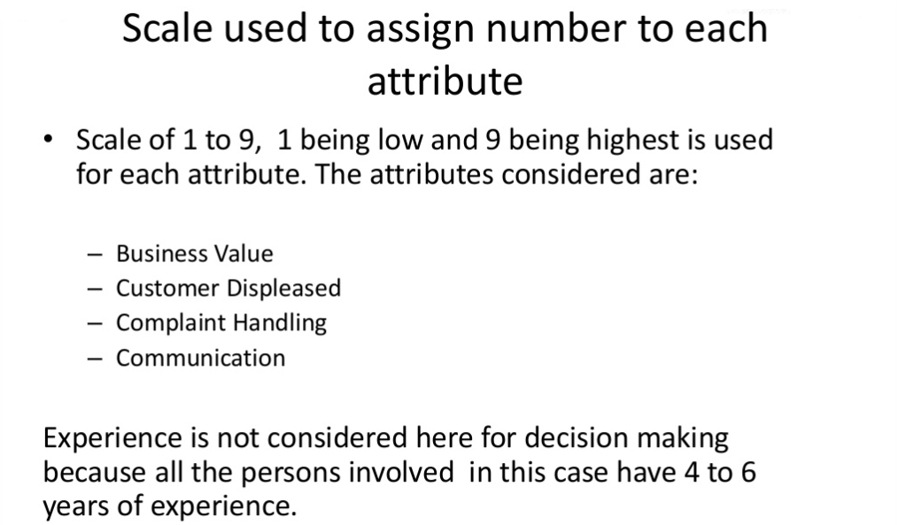

Slide 21
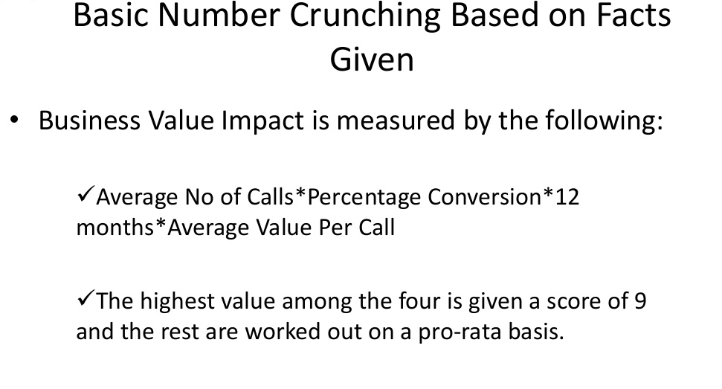

Slide 22
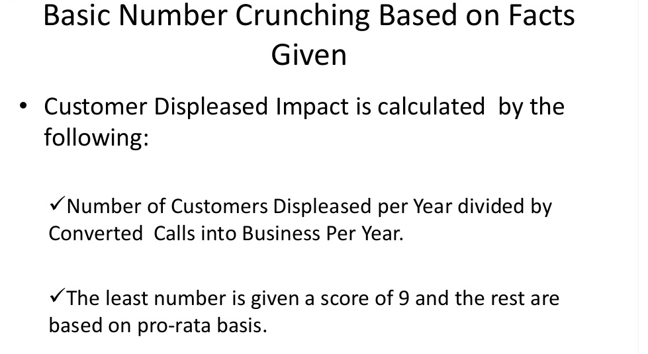

Slide 23
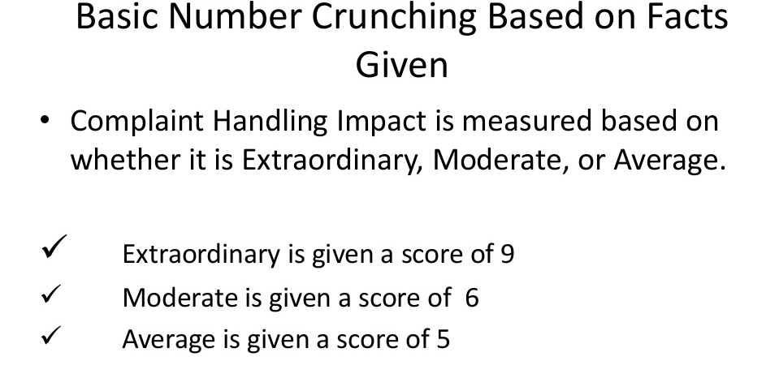

Slide 24
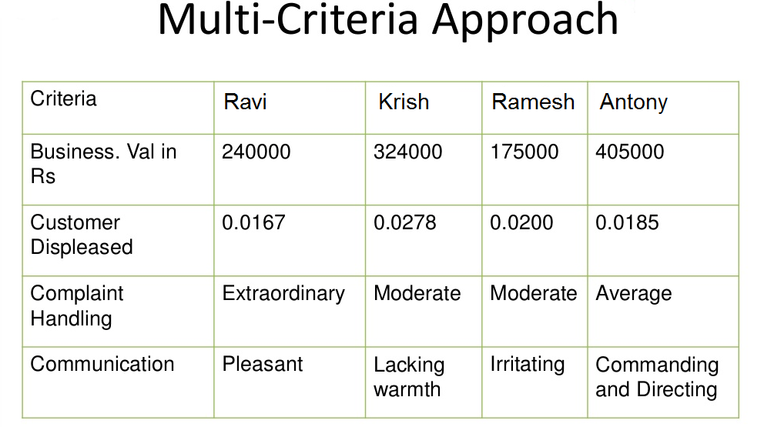

Slide 25
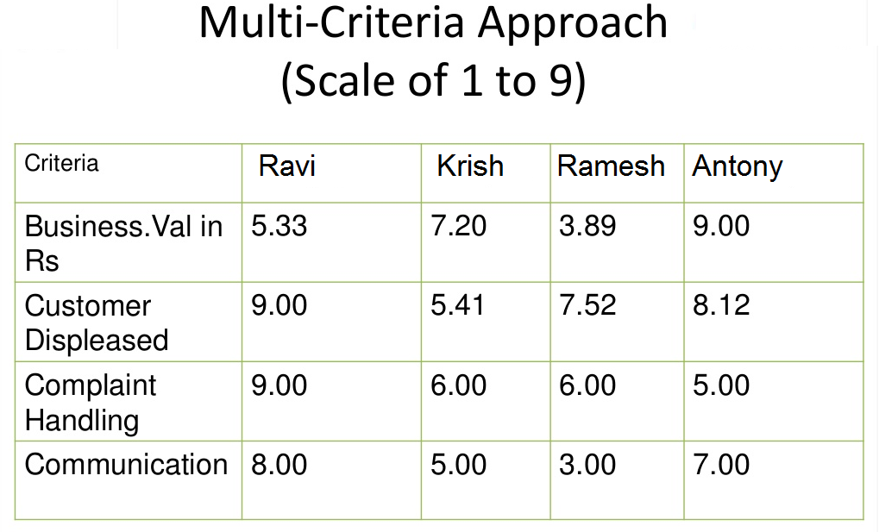

Slide 26
